Slide 1

Abstract Art Evolution Using Genetic Algorithm
Team Members
Aniket Patil
Keegan Dsouza
Atharv Chaudhary
Aryan Samant
Mini Project Guide: Archana Arudkar

Slide 2
Sr No. | Contents | Page No.
1 | Introduction
2 | Problem statement
3 | Objective and Scope
4 | User Interface
5 | Technologies Used
6 | Idea and Innovation (with Flowchart and Block Diagram)
7 | Conclusion
Table of Contents

Slide 3

Introduction
A user-friendly system utilizing genetic algorithms to transform input images into diverse, compact, and visually striking abstract art.
With a sleek User Interface powered by React, our aim is accessibility for users of all backgrounds.
Noteworthy features include diversity and entropy-based fitness functions.
Painterly filters play a pivotal role in refining and enhancing the aesthetic qualities of images

Slide 4
Problem Statement and Solution
Compact Image Synthesis : Develop an efficient, robust system for generating compact images while preserving key characteristics.
Optimization and Scalability : Address fine-tuning challenges in genetic algorithm parameters. Optimization of the genetic algorithm for efficiency
Painterly Filters Integration : Integration of painterly filters to enhance artistic quality

Slide 5

Implementation

Slide 6
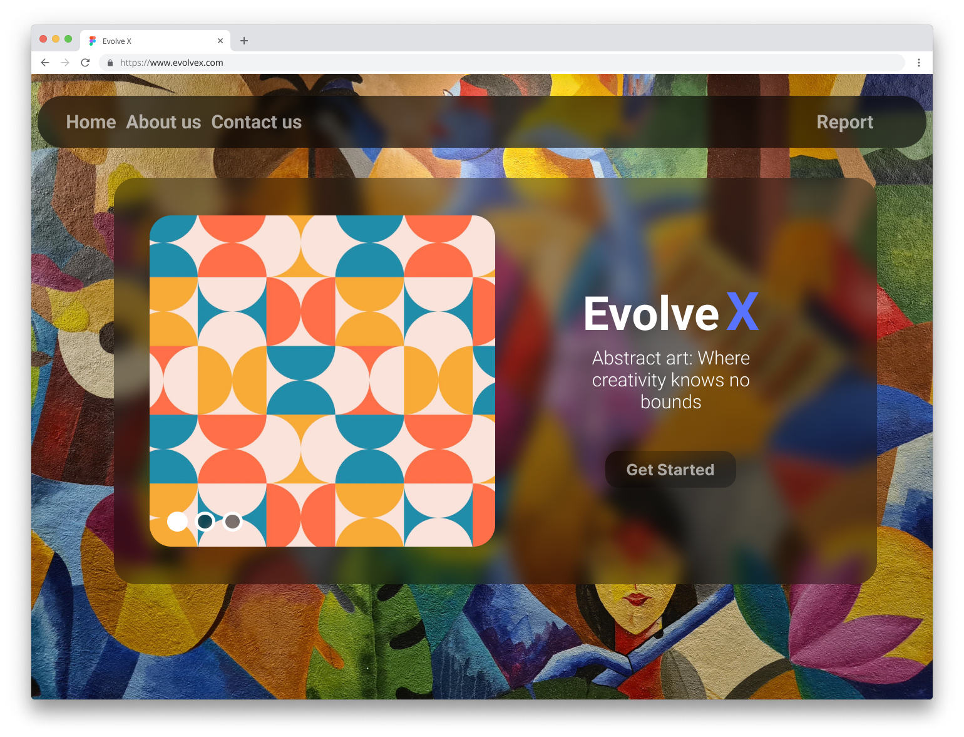
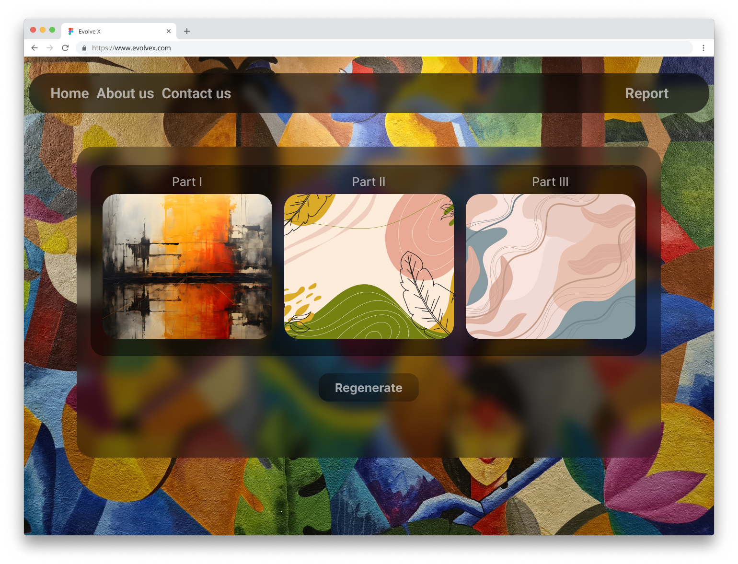
User Interface 🌍
With the click of this button, the user will be prompted to select the image of his choice …
After a while….👉

Slide 7







Technologies Used

Slide 8
Methodology
User-friendly interface for image upload and interaction.
Image parameter generation based on uploaded image characteristics.
The use of genetic algorithms to create diverse image variations.
Artistic changes applied to images
User's choice drives the selection of the final image or regeneration
Final images, either regenerated or original, are made accessible to the user.

Slide 9
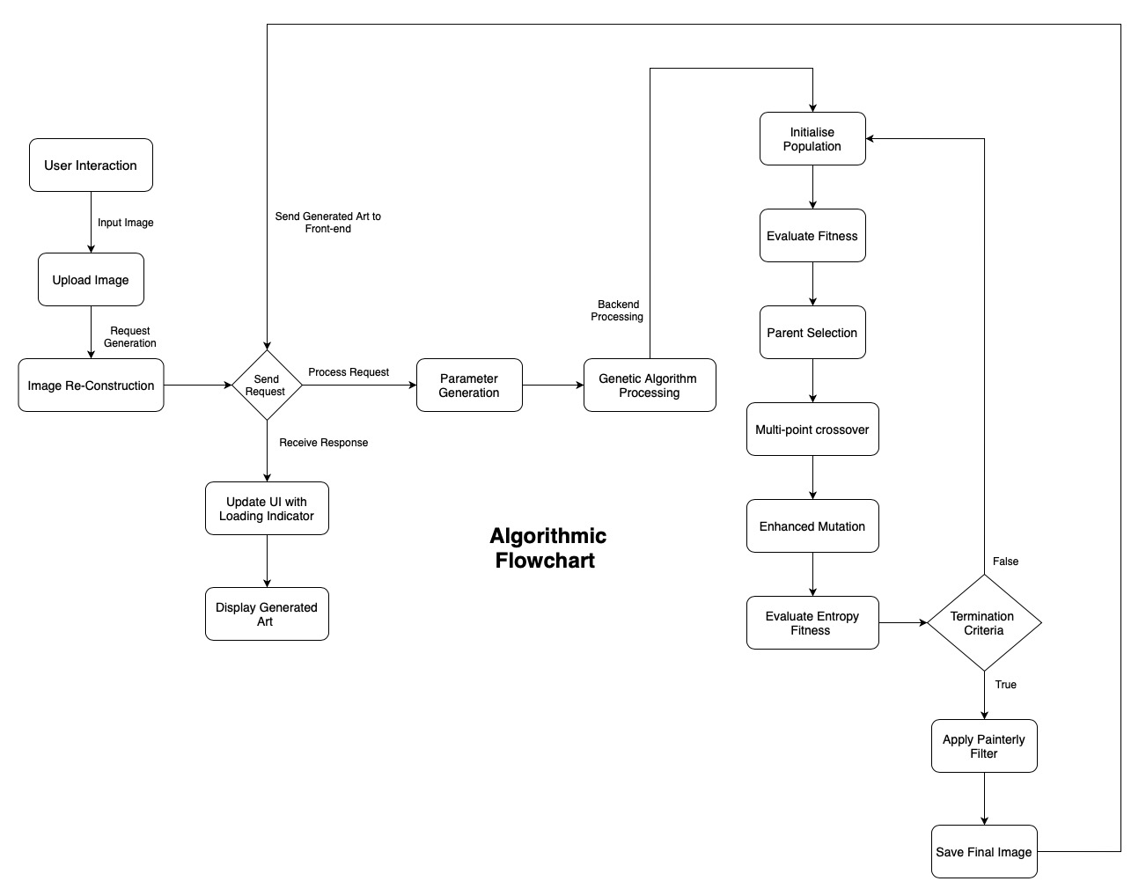
Flowchart

Slide 10
Innovation
Experimentation and Parameter Control
Art and Science Synergy
Crossover and Mutation Techniques
Multifaceted Fitness Functions

